Slide 1
Microservices, monoliths, docker
Notes:
So what is .NET?

Slide 2
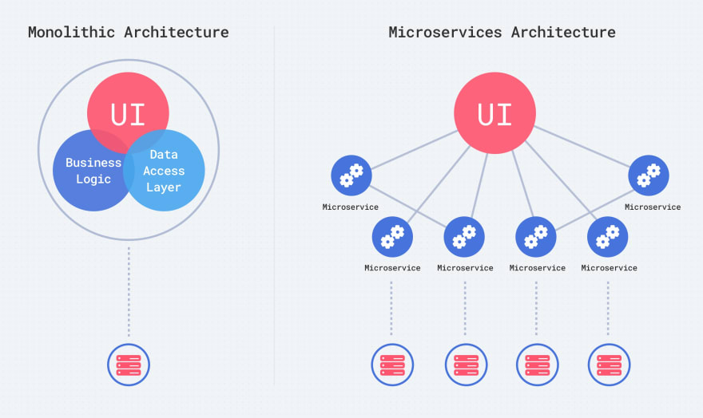

Slide 3
http://www.kamilgrzybek.com/design/modular-monolith-primer/

Slide 4
DevOps concept

Slide 5

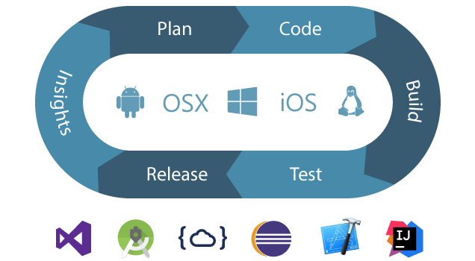
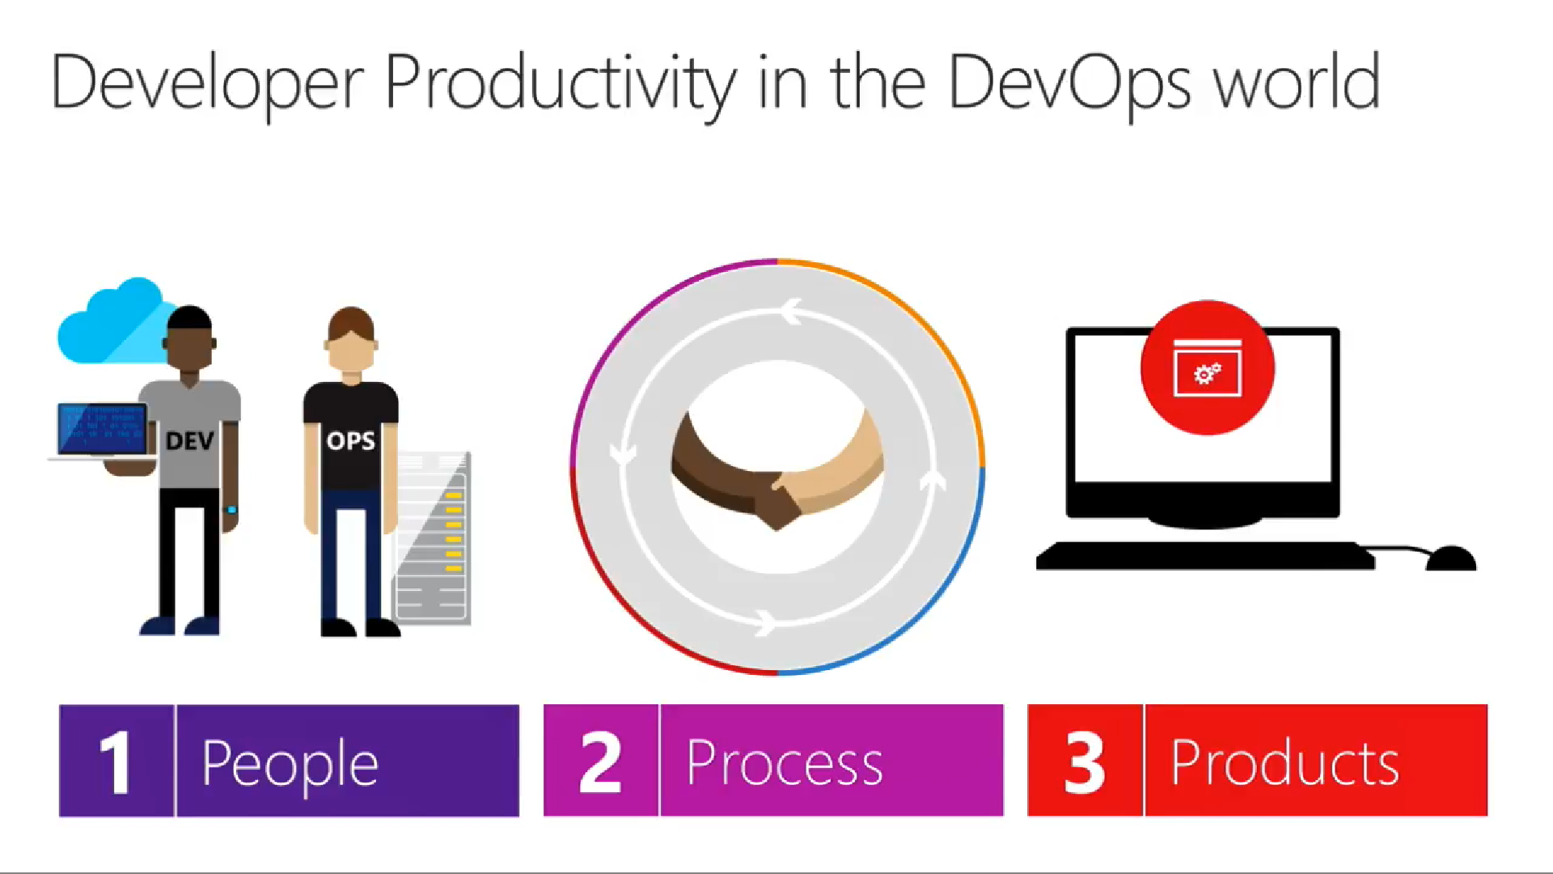
DevOps
Is
the union of people, process, and products to enable continuous delivery of value to our end users
Donovan Brown
Notes:
Dlaczego w ogole DevOps
DevOps to polaczenie ludzi procesow produktow I narzedzi w celu umozliwienia ciaglego dostarczania wartosci do uzytkownika.
Nawiazanie do konf I wszyscy mowia o devopsach
Donowan
Moja definicja deva I devopsa
Polaczenie
Procesy. Kultura pozawalajaca na bledy.
Bo mamy narzedzia. Eliminacja elementu ludzkiego

Slide 6
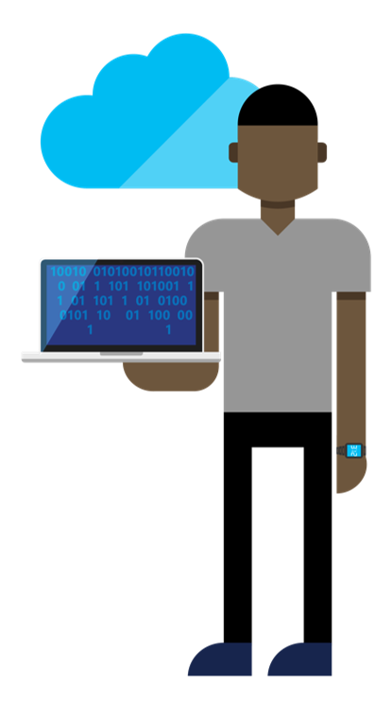
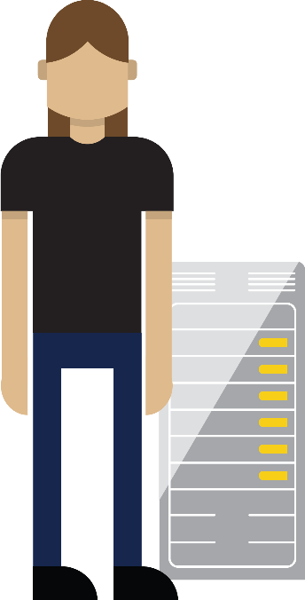

The first way (systems thinking)
DEV
OPS
Notes:
Sciana pomiedzy dev I ops. Mnie ominela ale teraz mnie uderzy…
Podzial na oddzialy/departamenty/wydzialy/dzialy
Dostarczanie produktu nie wartosci.
The First Way emphasizes the performance of the entire system, as opposed to the performance of a specific silo of work or department - this can be as large as a division (e.g., Development or IT Operations) or as small as an individual contributor (e.g., a developer, system administrator).
It begins when requirements are identified (e.g., by the business or IT), are built in Development, and then transitioned into IT Operations, where the value is delivered to the customer.
When we think as a system, we can focus clearly on the business value that flows between business, dev, ops, and end users.
The outcomes of putting the First Way into practice include never passing a known defect to downstream work centers, never allowing local optimization to create global degradation, always seeking to increase flow, and always seeking to achieve profound understanding of the whole system.

Slide 7


The second way (feedback loops)
DEV
OPS
Notes:
FEEDBACK loop
Experimenting
Powolne wracanie do korzeni – wspolpraca oddzielnych dzialow
The Second Way is about creating right to left feedback loops.
The goal of almost any process improvement initiative is to shorten feedback loops so necessary corrections can be made quickly and continuously.
The outcomes of the Second Way include understanding and responding to all customers, internal and external, shortening and amplifying all feedback loops, and embedding knowledge where we need it.

Slide 8




Contrasting ALM and DevOps
DEV
OPS
Notes:
Polaczenie dzialow, przesuniecie odpowiedzialnosci.
Dostarczanie wartosci dla uzytkownikow a nie realizacja taskow z backlog.
Kolaboracja na poziomie zespolu produktowego nie na poziomie dzialow operacyjnych firmy.
Application lifecycle management is the product lifecycle management (governance, development, and maintenance) of software.
ALM describes how all roles in a software development project are in sync with each other throughout all application development stages.
Microsoft has been delivering solutions for teams to improve agility in the Application Lifecycle for more than 10 years by helping development & test teams collaborate better and deliver value more quickly.
Such integration ensures that every team member knows Who, What, When, and Why of any change made during the development process and that there is no last minute surprise causing delivery delays or project failure.
With development and test teams delivering value faster, we now want to focus on helping Ops release more efficiently and reliably.

Slide 9
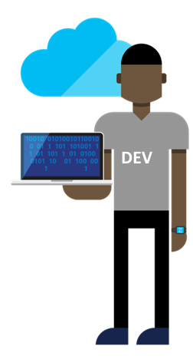
Contrasting ALM and DevOps
DEV
OPS
Notes:
Dla mnie duzo wiecej jest na dev niz na ops bo cos o czym sie nie mowi to druga strona medalu
Czyli – JAK zaprojektowac, napisac aplikacje aby byla latwo dostarczalna
Architekci/Team Leaderzy wybieraja technologie,
wybieraja infrastructure (chmurowe zycie),
wybieraja narzedzia,
tworza infrastructure testowa
- Nie moga tego robic w oderwaniu od devops. To ich odpowiedzialnosc, mimo ze moze ja realizowac kto inny.

Slide 10
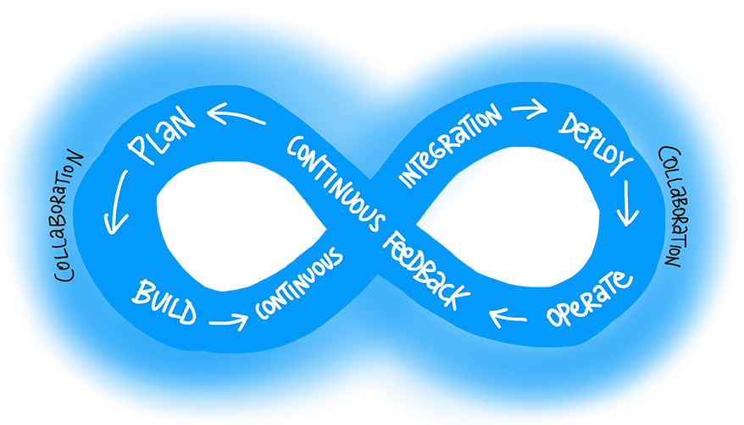

Notes:
Teraz zaczyna mowic sie o tym ze devops w pelnym cyklu jest zastapienieym agile.
KOLABORACJA
Polaczenie
Procesy.
Kultura pozawalajaca na bledy. Na eksperymentowanie,
narzedzia wspomagaja pewnosc
Bo mamy narzedzia.
Eliminacja elementu ludzkiego – That One Guy that knows how to deploy
Devops powinien byc nowymi okularami przez ktore patrzymy na swiat

Slide 11

Azure DevOps Free
private repos with unlimited space
5 users & unlimited stakeholders
240”/month cloud build time
1 private agent
20K virtual user minutes for Load Testing
SLA 99.9%
Notes:
Narzedzia wpomagajace - vsts
Czemu lubie vsts
- kontrola wersji, private repo, unlimited space.
Zarzadzanie zadaniami- powiazanie wszystkich elementow
Build system ktory nie zabija
Latwosc konfiguracji agentow
Czemu warto teraz isc w vstsa ?
Bo ms pcha w azura I roznorodnosc wiec ich pipeline musi byc idealny zeby to wspierac

Slide 12
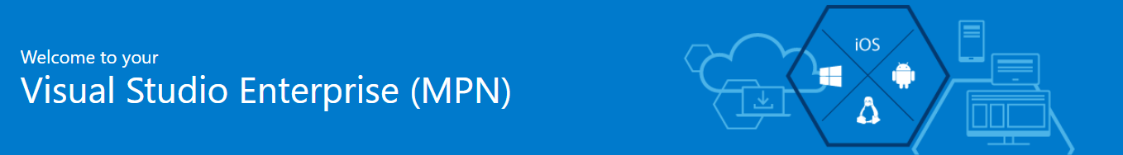
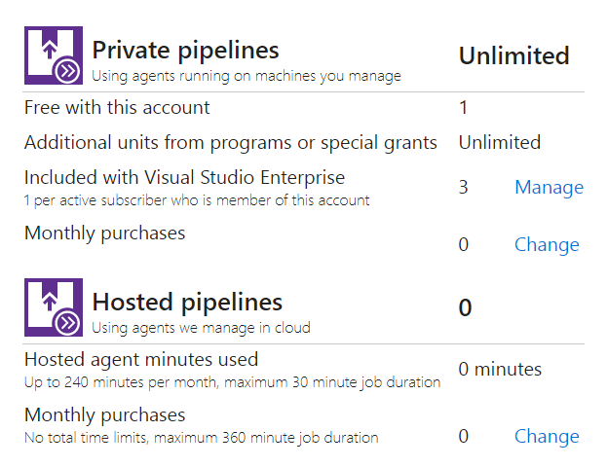
VSTS user (free of charge)
1/active MSDN subscriber private build agent
150$ (or 50$) per month Azure subscription credits
free VM that can be agent starting at 8$/month
Notes:
Korzysci z msdna
Azure
Azure daje nam paas na srodowiska
Azure daje nam kase na maszyny virtualne
Azure I aad in vsts daje nam unlimited agentow
Darmowa wersja - ograniczenia. Wykupiona wersja ograniczenia.
Rozmawiamy o corpo podejsciu.

Slide 13
Architecture

Slide 14
Architecture history
Spaghetti
A log of copy-paste
Whole application deployed/ delivered as one piece
Lasagne
3 layered architecture
DB, Business Logic, Frontend – different teams, with separated responsibilities
Whole application deployed/ delivered as one piece
Ravioli
Microservices
Should be atomic
Should implement whole functionality
Cross-functional teams
Each piece can be deployed independently
Notes:
Zespoly pizzowe – Jeff Bezos 5-7 osob w zespole – czyli 2 pizze

Slide 15
12 factors
I. Codebase
One codebase tracked in revision control, many deploys
II. Dependencies
Explicitly declare and isolate dependencies
III. Config
Store config in the environment
IV. Backing services
Treat backing services as attached resources
V. Build, release, run
Strictly separate build and run stages
Notes:
1. git. CaaC
2. – nugety, .net core – nie zalezmy od system. Salf-contained -> docker file
3. Konfiguracja – jedyna rzeczy rozniaca srodowiska. Przekazywanie przez zmienne srodowiskowe.
4. Bazy, kolejki, emaile, smsy -> configuration as a code
5. Publikacja – budujemy paczki deploymentowa i laczymy z konfiguracja srodowiska.
uruchomienie tutaj to release
- pamietajmy o nr releasow, wersjonowaniu
- artefakt powinien byc trwaly I niemodyfikowalny

Slide 16
12 factors
VI. Processes
Execute the app as one or more stateless processes
VII. Port binding
Export services via port binding
VIII. Concurrency
Scale out via the process model
IX. Disposability
Maximize robustness with fast startup and graceful shutdown
Crash-only architecture
Change “at most once” to “at least one” processing
Notes:
6. bezstanowo. Stan- usluga wspierajaca. Lokalny cach czy Sticky sessions – zlamanie zasady.nie zakladamy ze nasz uzytkownik podlaczy sie do danego serwera!
7. Kazda usluga ma swoj port I protocol – kazdy serwis stoi na innym porcie.
8. skalowanie. Aplikacja musi byc w stanie pracowac w oparciu o wiele procesow dzialajacych na wielu fizycznych maszynach. Wtedy kazdy process skalujemy osobno horyzontalnie. Out czyli w szerz. Bo Up mozemy tylko do jakiegos poziomu
9. zbywalnosc.kazdy process moze byc zatrzymany I zniknac. A gdy kolejnym razem bedziemy go potrzebowac to bedzie to nowy process moze nowa maszyna. COLD START. Obsluga kolejek I asynchronicznosc – kto obsluguje wiadomosc I czy skonczyl. Flush do logow
SIGTERM
-> crach –only – chaos monkey

Slide 17
12 factors
X. Dev/prod parity
Keep development, staging, and production as similar as possible
XI. Logs
Treat logs as event streams
XII. Admin processes
Run admin/management tasks as one-off processes
Notes:
10. Zmiejsz czas deployment.
Testuj I programuj na tym samym systemie, z taka sama konfiguracja z tymi samymi narzedziami
11. Logi na console + do zbiorczego miejsca Splunk, Elk, Elastik Search, application Insights
12. Automatyzacja daje procesy. Albo inaczej DEVOPS :D CI/CD as a code

Slide 18
Kubernetes
afun60

Slide 19
Thanks! Questions?

